Slide 1
Marching Cubes Terrain Generator
with Unity & Compute Shaders
Jens Lehmann, Tim Wolfsegger

Slide 2
Problem
Generating 3D terrains has been a challenge in the field of computer graphics and video game development for years
With the increasing demand for realistic and immersive 3D experiences, there is a need for automated procedural solutions that can generate high-quality terrain models efficiently
„Traditionally procedural terrains have been limited to height fields that are generated by the CPU and rendered by the GPU. However, the serial processing architecture of the CPU is not suited to generating complex terrains which is a highly parallel task“ (Geiss, 2007)

Slide 3
Marching Cubes Algorithm
Paper introduced by William E. Lorensen and Harvey E. Cline in 1987 (Marching Cubes: a high resolution surface construction algorithm)
Idea: dividing a 3D space into a grid of smaller cubes and then marching from one cube to the next, determining how the surface of the object intersects each cube. (Lorensen & Cline, 1987)

Slide 4
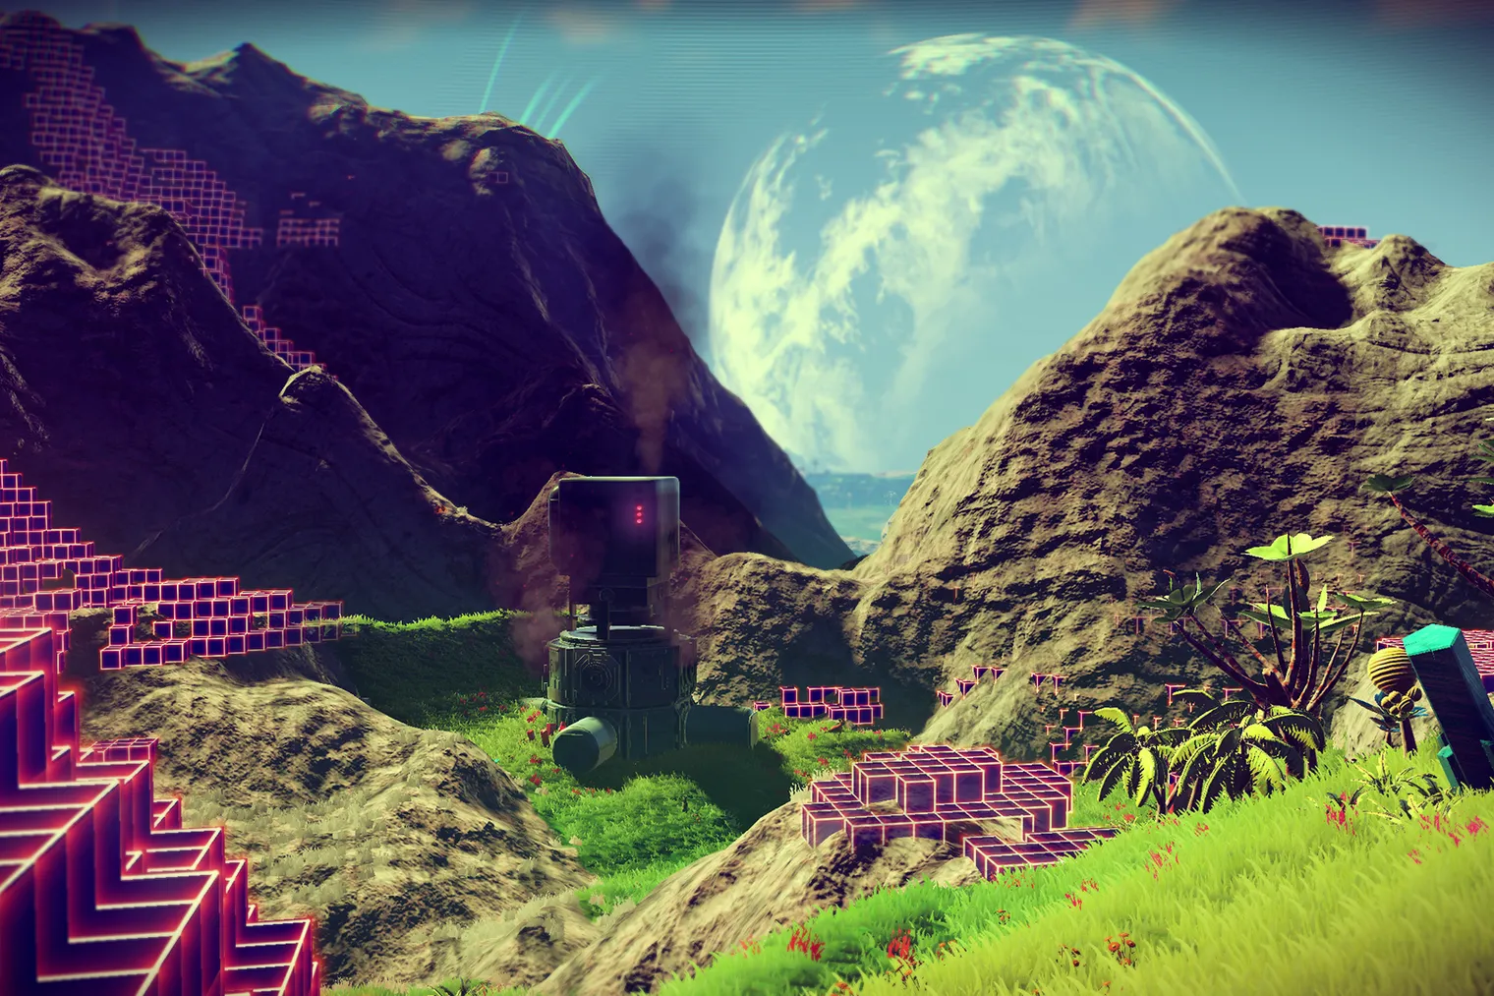

How did we get the idea?
Source: https://cdn.voxcdn.com/thumbor/CY5XmFg8Xxw9Z6H9u2fCpEBRTHE=/0x0:1920x1080/1520x1013/filters:focal(807x387:1113x693):format(webp)/cdn.voxcdn.com/uploads/chorus_image/image/53502761/ResourceLab.0.0.png
Source:
https://lowcygier.pl/wp-content/uploads/2021/06/No-Mans-Sky-miniaturka-scaled.jpg

Slide 5
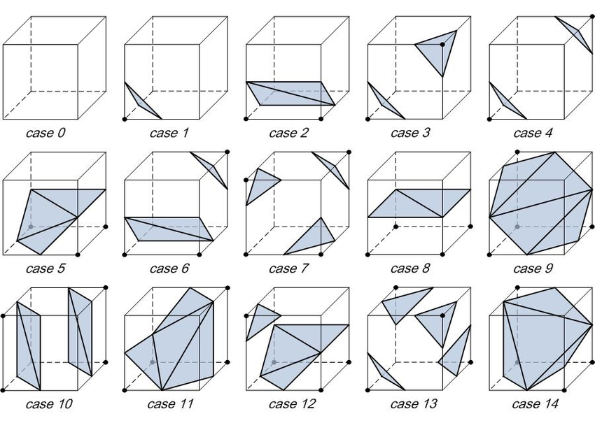
Step by Step
Define a 3D grid. Every point in the 3D grid is a value from a fixed range.
The grid is divided into a grid of smaller cubes.
Define an ISO-Value. Values in the grid below that threshold are on one side of the surface represented by the voxels, values above the threshold are on the other.
This means there are 256 triangular divisions for each cube. However, a large part of them is symmetrical or rotated. => only 15 different cases.
Source:
https://www.researchgate.net/figure/Type-of-surface-combinations-for-the-marching-cube-algorithm-The-black-circles-means_fig2_282209849
Lorensen and Cline (1987)

Slide 6
Step by Step
For each cube, the algorithm uses a lookup table to determine the shape of the surface.
After that we generate vertices
Connect vertices to form a mesh
Render the mesh
Source:
https://www.researchgate.net/figure/Type-of-surface-combinations-for-the-marching-cube-algorithm-The-black-circles-means_fig2_282209849
Lorensen and Cline (1987)

Slide 7
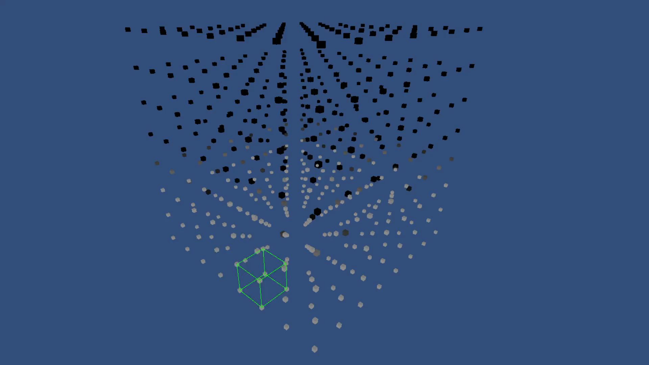

Slide 8
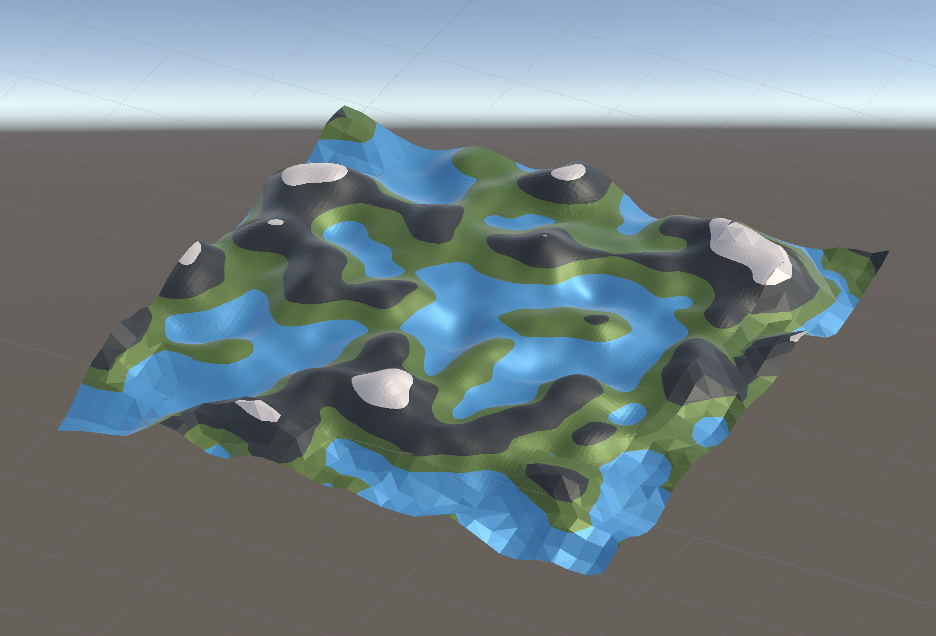
How we implemented it
Calculate the Density Function in a Compute Shader using different Noise Patterns for different terrain-effects. We implemented a 3D Simplex Noise and 2D Perlin Noise to generate our Grid. Furthermore, the user can manually adjust features like octaves, frequency and amplitude of the noise.
In another Compute Shader the Marching Cubes algorithm then computes the verts with the help of a lookup table in parallel.
Finally, the Mesh is rendered (Camera etc.!!!!!)
Source: Screenshot from our Implementation

Slide 9
Benefits
Marching Cubes Algorithm offers a solution by generating 3D terrain models with high detail and efficiency
By implementing it as a shader, we were able to significantly improve performance because the computations run on the GPU to generate large, detailed landscapes in real-time
Variable levels of detail

Slide 10
DEMO OF OUR IMPLEMENTATION

Slide 12
Challenges
Compute Shaders: We had a hard time getting comfortable with using compute shaders. Especially since there are no real debugging possibilities.
Density Function: We needed time to find out how the density function could be parameterized for good looking terrains
Performance: Even after implementing the heavy lifting with Compute Shaders, we needed to do some tweaking to further improve the Terrain Generation (e. g. by implementing LOD)

Slide 13
Improvements in the future
Improving realism
Advanced materials and textures
Further improve Chunk Management and Performance
Dynamic Terrain

Slide 14
THANK You for your Attention

Slide 15
Sources
Geiss, R. (2007). Generating complex procedural terrains using the GPU. GPU Gems 3. Pearson Education. Chapter 1, pp. 7-37.
Lorensen, W. E. & Cline, H. E. (1987). Marching cubes: A high resolution 3D surface construction algorithm. Proceedings of the 14th annual conference on Computer graphics and interactive techniques - SIGGRAPH ’87. https://doi.org/10.1145/37401.37422

